Slide 1

Chapter 13
Programming and Languages
Computing Essentials 2023
O’Leary
Notes:
The chapter introduces you the software development life-cycle and programming languages.

Slide 2
Learning Objectives
Define programming and describe the six steps of programming.
Compare design tools including top-down design, pseudocode, flowcharts, and logic structures.
Describe program testing and the tools for finding and removing errors.
Describe C A S E tools and object-oriented software development.
Explain the five generations of programming languages.
Notes:
Review the Learning Objectives with students to help them understand what they need to get from the chapter.

Slide 3

Introduction
In this chapter, you focus on Phase 4, Systems Development, of the systems life cycle and learn about the programming process and some of the programming languages that are available.
Competent end users need to understand the relationship between systems development and programming.
Dean Drobot/123RF

Slide 4
Programs and Programming
Program
A list of instructions for the computer to follow to accomplish the task of processing data into information.
Statements used in a programming language such as C++, Java, or Python.
Programs can be:
Prewritten/packaged.
Custom-made.
Programming or Software Development
A problem-solving procedure.
List of instructions for the computer to follow to process data.
Follows a six-step process know as the System Development Life Cycle.
Notes:
A program (key term) is a list of instructions for the computer to follow to accomplish the task of processing data into information
Programming (key term) also known as software development (key term) or the software development life cycle (SDLC) (key term)

Slide 5
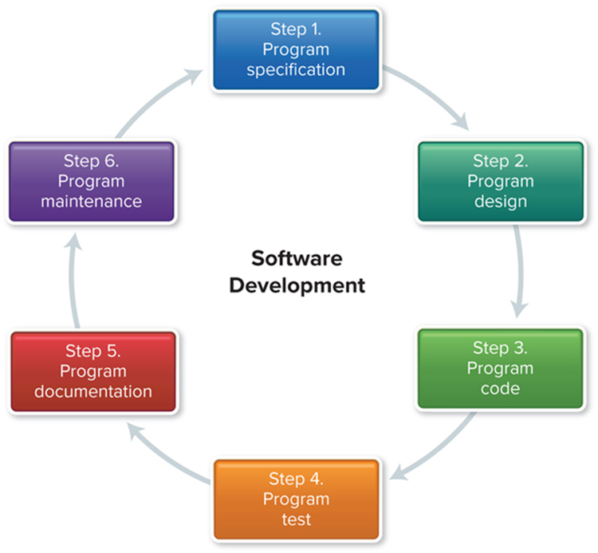
Six-Step Software Development Life Cycle
The six steps are as follows:
Program specification.
Program design.
Program code.
Program test.
Program documentation.
Program maintenance.
Access the text alternative for slide images.
Figure 13-1
Notes:
When writing a program from scratch, the programmer (key term) or software engineers (key term) generally follows these six steps to obtain an end product that will solve your computing needs.
The specifications are the objectives (Key Term), the output, the input, and the processing requirements that are determined by you and the programmer.
The design is the creation of the solution using a variety of techniques (generally including pseudocode, flowcharts, and logic structures.
The program code is written
Testing code or debugging to get rid of syntax and/or logic errors.
The program is documented as it is written. Sometimes this is done within the code itself (as with some Web languages where you can insert explanations without this information showing on the page); other times the documentation is done in a “manual” that will help others see where you have been/gone/or how you got where you did with your coding.
Program maintenance – As with system analysis and design, an on-going part of every software development is the maintenance – checking to be sure the program is doing what it is supposed to do and that the objectives have not changed.
In organizations, computer professionals known as software engineers (Key Term) or programmers (key term) use this six-step procedure

Slide 6
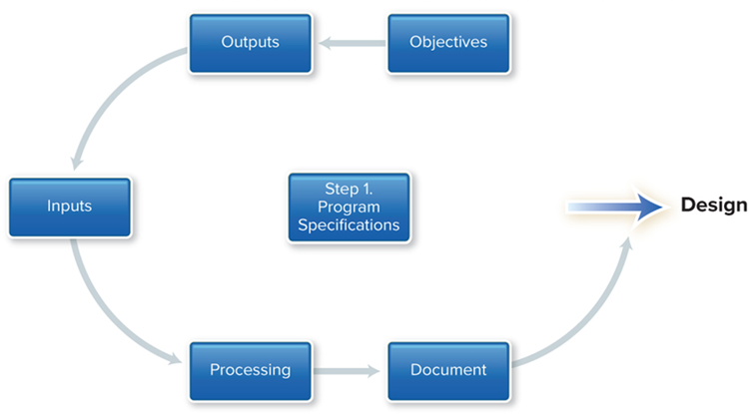
Program Specification
Also called program definition or program analysis
Five items must be specified:
Program’s objectives.
Desired output.
Input data required.
Processing requirements.
Documentation.
Access the text alternative for slide images.
Figure 13-2
Notes:
Program specification (key term) also called program definition (Key Term) or program analysis (key term)– requires that five items are specified—
1. the program’s objectives
2. the desired output
3. the input data required
4. the processing requirements
5. the documentation

Slide 7
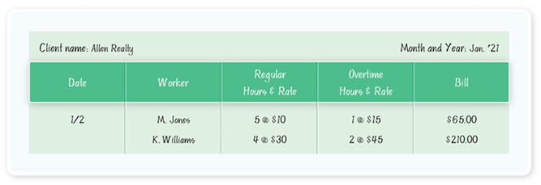
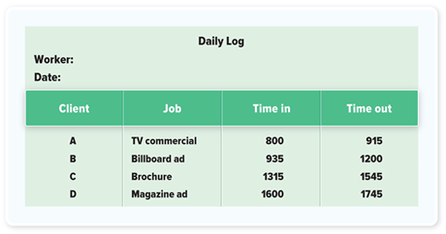
Defining Program Specification
Program objectives
Requires a clear statement of the problem being addressed.
Desired output
The end-user should communicate the inputs and outputs.
Input data
Determine the source of the data.
Processing requirements
Tasks to move input to output.
Program specification document
Document program specifications.
Access the text alternative for slide images.
Figure 13-3 and 13-4
Notes:
Have program objectives (key term)
What problems are you trying to solve?
Programming requires a clear statement of the problem that you are looking to address
Specify your inputs before your outputs
Have a list of what you want to get out of the system
The end-user (not the programmer) should sketch what is needed
Input data
Determine the source of the data
What are the processing requirements?
Tasks to move input to output
Document program specifications
This is an essential step and is often left out

Slide 8
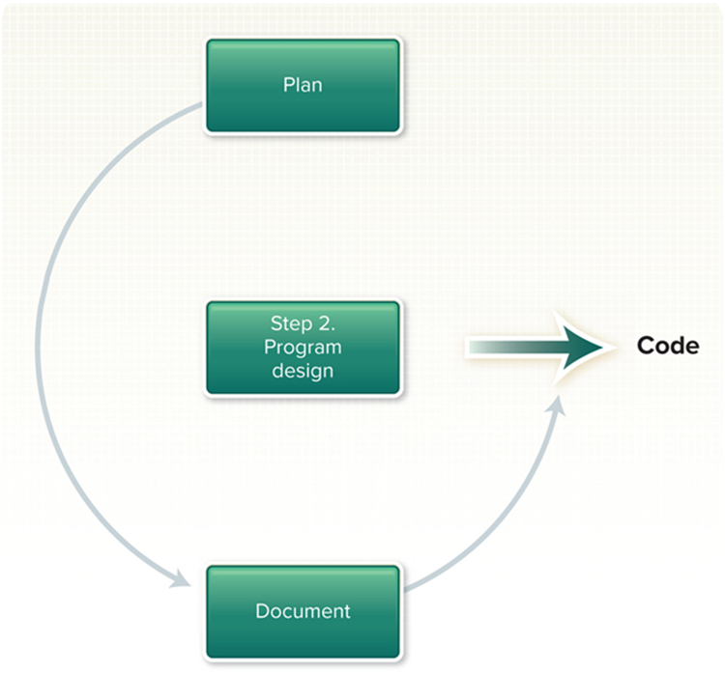
Program Design
Plan a solution using structured programming techniques
Techniques:
Top-down design.
Pseudocode.
Flowcharts.
Logic structures.
Figure 13-5
Notes:
In this step you begin program design (key term) , the solution is created using structured program techniques (Key Term) .
These techniques consist of:
top-down design
Pseudocode
Flowcharts
Logic structures

Slide 9
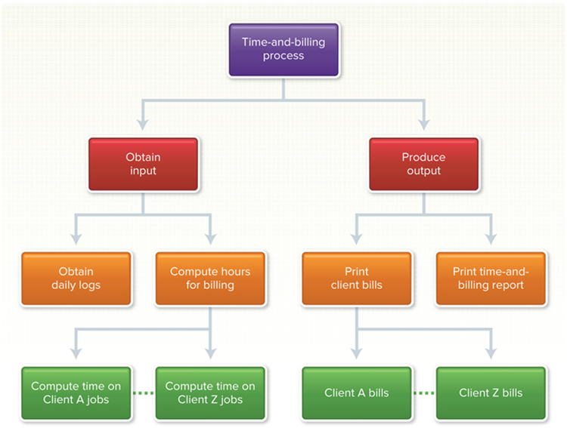
Top-Down Program Design
To identify the program’s processing steps; called modules
Each module is made up of logically related program statements.
Access the text alternative for slide images.
Figures 13-6
Notes:
First determine the outputs and the inputs of the program
Use top-down-program design (key term) to identify the program’s processing steps
Such steps are called program modules (Key Term) or just modules (Key Term)
Each module is made up of logically related program statements
Each module should have a single function
The program must pass in sequence from one module to the next until all modules have been processed by the computer
Review the above example with the students
It is for a time-and-billing report program

Slide 10
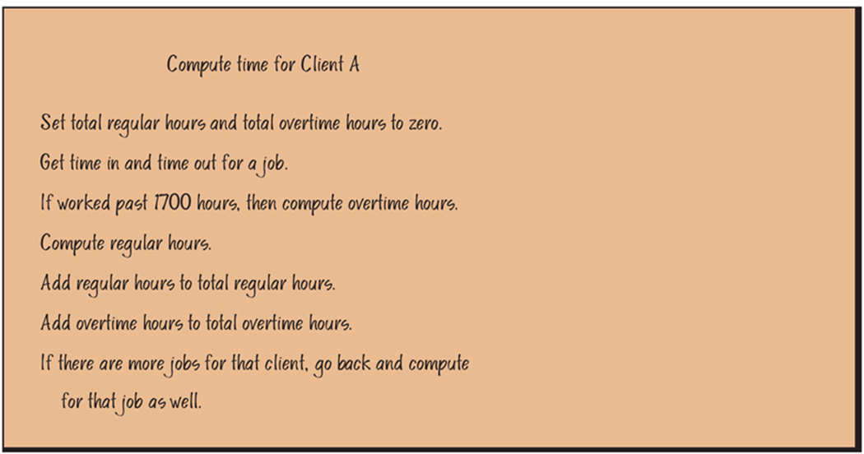
Pseudocode
An outline of the logic of the program you will write.
Summary of the program before it is written
Access the text alternative for slide images.
Figures 13-7
Notes:
Pseudocode (key term) is an outline (in English) of the logic (route) the program will take.
It is like doing a summary of the program before you write it

Slide 11
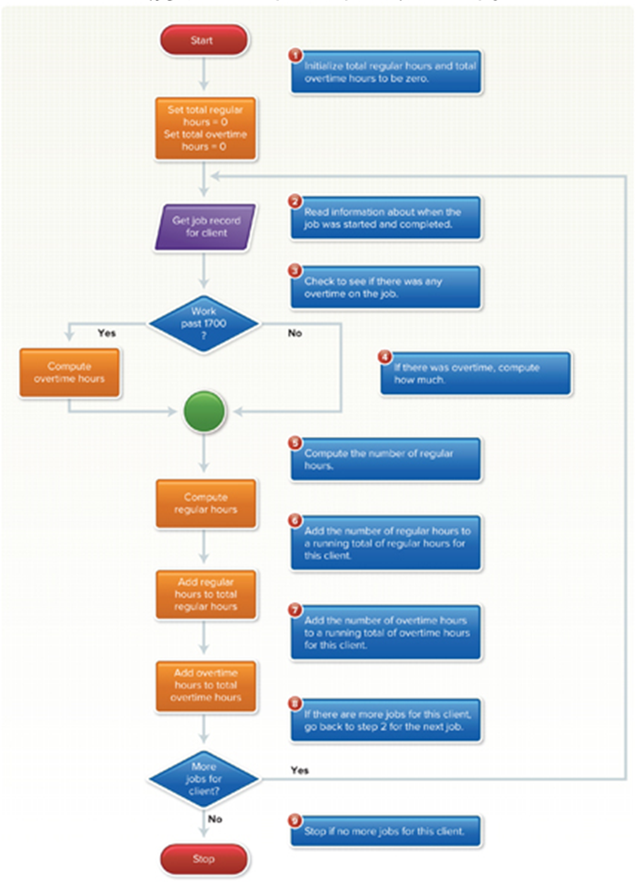
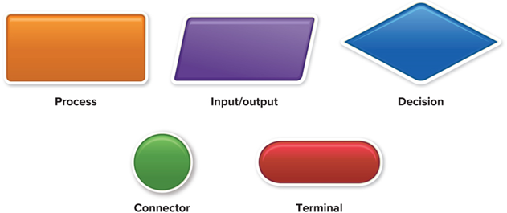
Flowcharts
Graphically present the detailed sequence of steps needed to solve a programming problem
Access the text alternative for slide images.
Figures 13-8 and13-9
Notes:
Program flowcharts (Key Term)
Keep in mind that a computer performs instructions in steps
It does more than arithmetic; it makes comparisons

Slide 12
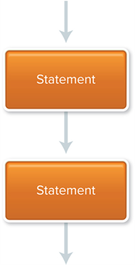
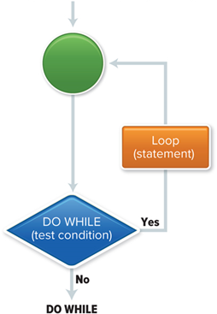
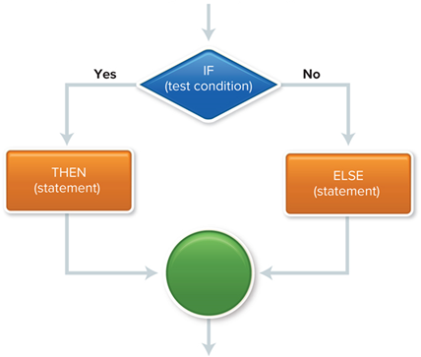
Logic Structures
Enables you to write structured programs, which take much of the guesswork out of programming
Sequential structure.
One program statement follows another.
Sequence
Repetition
Selection structure.
A decision must be made.
Selection
Repetition structure or Loop Structure.
Describes a process that may be repeated as long as certain condition remains true.
Access the text alternative for slide images.
Figures 13-10, 13-11, 13-12
Notes:
Talk about logic structures (key term) here – sequential (key term), if-then-else (Key Term); repetition structures (Key Term) and do while (Key Term). If a person looks at a problem, then automatically solves the problem by subconsciously saying “if I do this, then this will happen; if I do that, then (else) that will happen.” Computers do the same type of logic – except they have to be instructed to do this kind of thinking – i.e. the logic structure and the repetition.
You can link various parts of the flowchart with logic structures
There are three – sequence, selection, and repetition
Sequential structure – one program statement follows another
Selection – occurs when a decision needs to be made; IF-THEN-ELSE (key term)
Repetition or loop structure – describes a repeated process
Variations include
DO UNTIL
DO WHILE

Slide 13
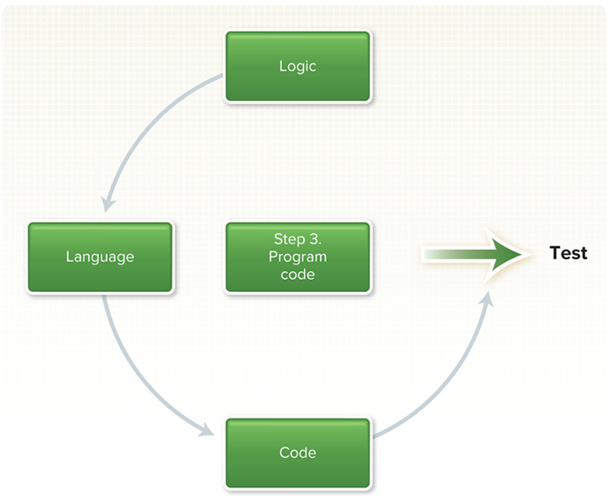
Program Code
Writing the program is called coding
Characteristics of a good program:
Reliable.
Produces the correct output.
Catches common input errors.
Well-documented and understandable.
Structured programs – one of the best ways to code effective programs.
Using logic structure.
Figure 13-13
Notes:
This is the easiest part where you actually write or key into the computer the instructions the program is to follow. Writing the program is called coding (key term)
To code effective programs, write so-called structured programs (key term)

Slide 14
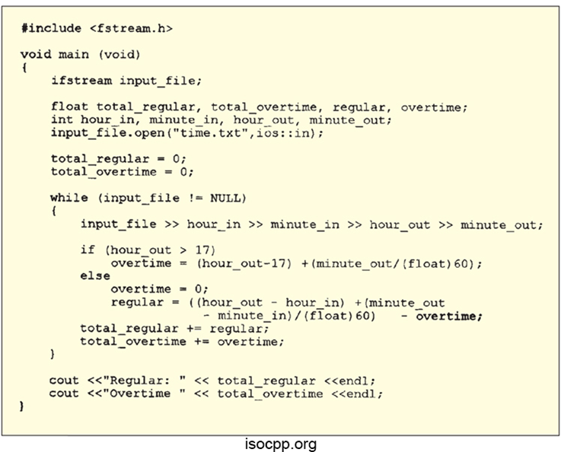
Coding
Write the program
A programming language uses a collection of symbols, words, and phrases that instruct a computer to perform specific operations.
Figure 13-14
Notes:
A content markup language (key term) uses symbols, words, and phrases that instruct a computer how to display information
Programming language (key term) uses a collection of symbols, words, and phrases that instruct a computer to perform specific operations.
Use the most appropriate language (C++, Java, etc.) for the situation for which the code will be used.

Slide 15
Programming Languages
Language | Description
C++ | Extends C to use objects or program modules that can be reused and interchanged between programs.
C# | A programming language designed by Microsoft to extend C++ for developing applications in the Windows environment.
Java | Primarily used for Internet applications; similar to C++; runs with a variety of operating systems.
JavaScript | Embedded into web pages to provide dynamic and interactive content.
Python | General-purpose programming language that is simple and easy to learn. Frequently used in introductory programming courses.
Swift | Uses graphical user interface and special code for touch screen interfaces to create apps for Apple iOS devices.
Figure 13-15
Notes:
Widely used programming languages

Slide 16
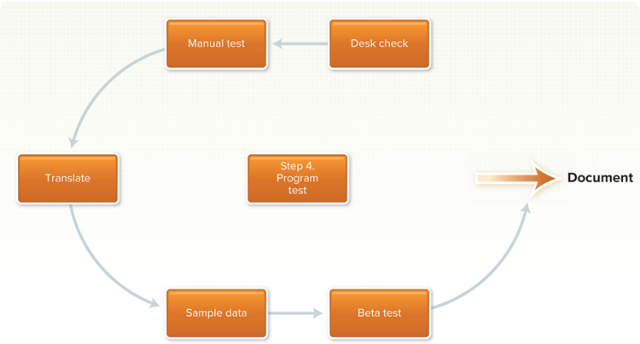
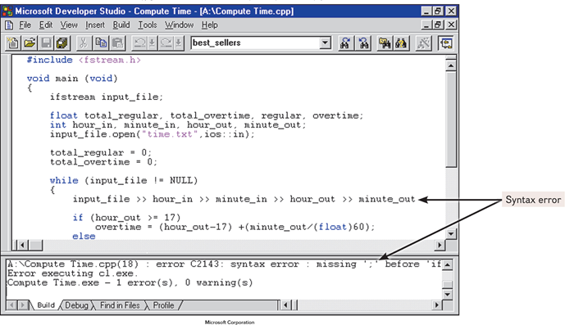
Program Test
Debugging
The process of testing and then eliminating errors such as:
Syntax errors are a violation of the rules of programming language.
Logic errors occur when the programmer uses incorrect calculation or leaves out a programming procedure.
Testing process involves one or more of several methods.
Access the text alternative for slide images.
Figure 13-16 and Microsoft Figure 13-17
Notes:
Now it’s written, so let’s test your program to be sure it does what you intended. This procedure sometimes is called “Debugging” (key term) —testing a program and correcting syntax and logic errors.
Syntax errors (key term) – violation of the programming language rules
Logic errors (key term) – result of omitted programming procedure or incorrect calculation
Testing process involves one or more of several methods.

Slide 17
Program Testing Processes
Desk checking or Code review
Printout of program reviewed line by line.
Manual testing with sample data
Correct and incorrect data manually entered, results evaluated.
Attempt at translation
Written program goes through translator program on the computer, must be syntax error free.
Testing sample data on the computer
Tests for logic errors.
Beta testing
Testing by a select group of potential users; users provide feedback.
Notes:
Desk checking (Key Term) or code review (key term)– printout of program reviewed line by line
Manual testing with sample data - correct and incorrect data manually entered, results evaluated
Attempt at translation – written program goes through translator program on the computer, must be syntax error free
Testing sample data on the computer – tests for logic errors
Beta testing (Key Term): testing by a select group of potential users (Key Term); users provide feedback

Slide 18
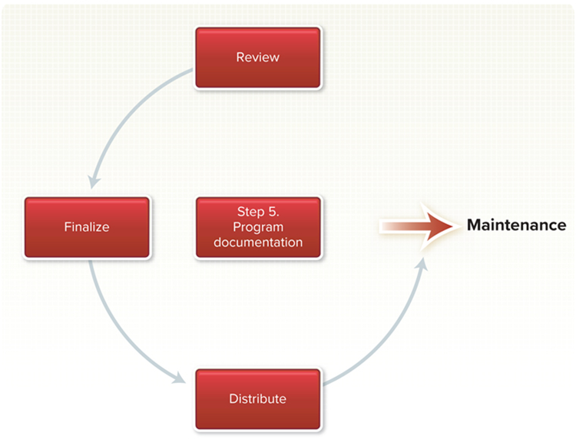
Program Documentation
Written descriptions and procedures about a program and how to use it
Carried on throughout the programing steps.
Important for people who will use and/or support the program
Users need to know how to use the software.
Operators need to know what to do about any error messages.
Programmers may even remember all the details.
Those taking over the program will need to know details.
Figure 13-19
Notes:
“Documentation” (key term) means writing a description of the purpose and process of the program.
Not an afterthought at the end of the programming process, but prepared throughout the programming steps
Program Documentation (key term) is very important to
Users (key term) - needing to know how to use the software; hardest part is to get documentation in “language” most lay people can understand. If you build something, you know what to expect; if someone else builds it, you may not understand why they did what they did.
Operators (key term) - for dealing effectively with error codes and other problems
Programmers (key term) - for updates and modifications; even programmers tend to forget how they came up with the “logic” of the program; documentation helps reconstruct the thought process and reasoning behind the code sequence.

Slide 19
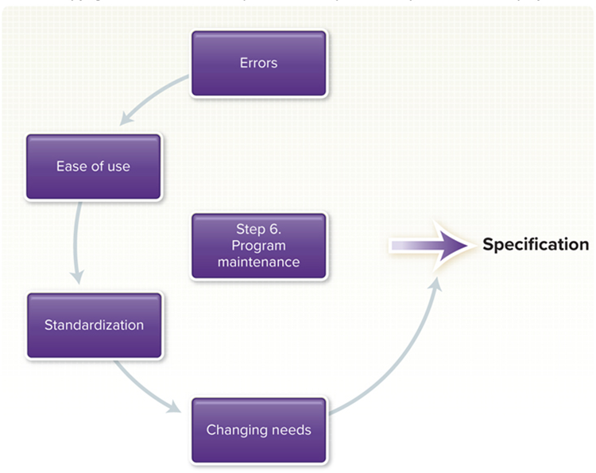
Program Maintenance
75% of total lifetime cost for an application is for maintenance.
Ensures program is:
Error-free.
Effective.
Efficient.
Two activity categories.
Operations.
Patches – programming modification or corrections.
Software updates – significant patches.
Changing needs.
Agile development – starts with getting the core functionality working then expands through to customer satisfaction.
Figure 13-20
Notes:
As with systems analysis, the program maintenance (key term) takes up the majority of the programmer’s time
This step is critical – to maintain the program and to be sure it is accomplishing what it was intended to accomplish
Operations – Use this part of the process to locate and correct any errors missed previously or that have developed over the life of the program
Programming modifications such as
patches (key term) – program modifications or corrections
software updates (key term) – significant patches
Changing needs – new tax laws, new information needs or new company policy
Agile development (Key Term) is a new development that gets the core functionality of a program working and then expands on it until the client is satisfied

Slide 20
Case Tools and Object-Oriented Programming
Computer-aided software engineering (C A S E)
Automates portions of the development process.
Object-oriented software – O O P
Focuses less on procedures, more on relationships with previously defined procedure.
Objects contain both the data and the processing operations needed to perform a task.
Notes:
Two resources that help software development include CASE tools (key term) and object-oriented software development
CASE tools help automate the process of designing, coding and testing activities.
OOP – program is organized into objects.
Each object (key term) contains both data and processing operations necessary to perform a task
Object-oriented software development (key term) – process by which program is organized into objects
OOP (key term) uses modules called objects that are reusable, self-contained components. Presume that certain functions are the same, so instructions are used in variety of software. C++ one of most widely used OOP languages

Slide 21
Generations of Programming Languages
Levels or Generations
Coding from machine languages to human or natural languages.
There are five distinct generations
Lower level is closer to machine language.
Higher level is closer to human-like language.
Notes:
Computer professionals talk about levels (key term) or generations (key term) of programming ranging from lower level (key term) to higher levels (key term).
Writing code means programmer has to learn a language
As we learned earlier, the computer only understands 0s and 1s. Therefore, the most basic of languages is called machine languages (key term) where all the instructions are written in a series of 0s and 1s
Needless to say, this makes understanding the instructions very hard for the average person
There is also “natural” languages that more closely simulate the way people actually talk and sort through problems
As computers have gone through generations, so have languages
Next slide displays all the levels of programming languages

Slide 22
Five Generations
1st Gen: Machine languages
Data represented in 1s and 0s.
2nd Gen: Assembly languages
Uses abbreviations or mnemonics that are automatically converted to the appropriate sequence of 1s and 0s.
3rd Gen: High level procedural languages (3GLs)
Designed to express the logic – the procedures – that can solve general problems. Translated into machine language with a compiler or an interpreter.
4th Gen: Task-oriented languages (4GLs)
Designed to solve specific problems.
5th Gen: Problem and Constraint languages (5GL)
Computer languages that incorporate the concepts of artificial intelligence to allow a person to provide a system with a problem and some constraints and then request a solution.
Notes:
Machine languages – data represented in 1’s and 0’s; hard to understand; vary according to make of computer!
Assembly languages (key term) – abbreviations and mnemonics replace the 0’s and 1’s; easier than machine, but still hard to understand for the common person. Advantage over machine language is that Assembly language is a portable language (Key Term) from one machine to another.
High level procedural languages (key term) – third-generation language (3GL) (Key Term). More closely resembles the way we talk, but still requires considerable training to be able to use and understand. When program written in procedural language, it must be translated into machine language using:
Compiler (Key Term) – converts high-level language (called source code (Key Term)) into machine language (called object code (Key Term)); once done execution faster -- or
Interpreter (Key Term) – converts to machine language just before processing, one statement at a time; easier to develop with
Problem-oriented languages are used for solving specific problems – fourth-generation language (4GL) (Key Term) – task-oriented languages (key term) . They generally require little special training on the part of the user. Also known as very high-level languages (Key Term).
Query languages (Key Term) - easy commands to retrieve information from databases
Application generators (Key Term) or program coder (Key Term) – preprogrammed modules written to perform a specific task
Reference the interactive financial planning system (IFPS) (Key Term)
Problem and constraint programming languages are still being developed; these are designed to replicate human languages. Hope is that in near future these languages can be developed to the point where they will enable a computer to learn – to remember and improve upon that memory
Fifth-generation language (5GL) (Key Term) uses natural languages (key term) to communicate

Slide 23
Generation Samples
Listed below are samples of each generation programming language in order from the 1st through the 5th
Generation | Sample Statement
First: Machine | 111100100111001111010010000100000111000000101011
Second: Assembly | ADD 210(8,13),02B(4,7)
Third: Procedural | if (score > = 90) grade =‘A’;
Fourth: Task | SELECT client FROM daily Log WHERE serviceEnd >17
Fifth: Problems and Constraints | Get patientDiagnosis from patientSymptoms "sneezing", “coughing” “aching”
Figure 13-23

Slide 24
Careers in I T
Computer programmers create, test, troubleshoot, update and repair programs
Employers seek individuals with
Degree in Computer Science or Information Systems.
Desired traits include patience, logical thinking, and attention to detail.
Computer Programmers can expect to earn $65,760 to $112,120 annually
Dean Drobot/123RF
Notes:
Many computer programmers work on a project basis as consultants
As technology has developed, the need for programmers to work on the most basic computer functions has decreased. However, demand for computer programmers with specializations in advanced programs continues.

Slide 25

A Look to the Future
Your Own Programmable Robot
To stay competitive with today’s fast business pace, new technologies must be incorporated.
Increased use of R A D and prototyping.
Increased use of outside consulting.
Sergey Nivens/123RF
Notes:
What if you could have your own robot to do your chores?
It is just a matter of time before these robots can understand human instructions instead of complex programming languages.

Slide 26
Open Ended Questions
Identify and discuss each of the six steps of programming.
Describe C A S E tools and O O P. How does C A S E assist programmers?
What is meant by “generation” in reference to programming languages? What is the difference between low-level and high-level languages?
What is the difference between a compiler and an interpreter?
What are logic structures? Describe the differences between the three types.
Notes:
Have students turn to the end of Chapter 13 in their textbooks to view the same “Open-Ended” questions/statements

Slide 27
End of Main Content
© McGraw Hill LLC. All rights reserved. No reproduction or distribution without the prior written consent of McGraw Hill LLC.

Slide 28
Accessibility Content: Text Alternatives for Images

